Slide 1
CLASS 1 · AI AS A BUSINESS TOOL
Your AI Workbench
A business concept. A checked update. Your own workflow.
S
R
G
A
Au
150
Search
Reason
Generate
Analyze
Automate
minutes, break included
Before we start — use fictional or anonymized information only. No passwords, no real customer, financial, or ID data. Removing a name alone may not make information safe.
Notes:
00–02. Welcome learners; state the outputs and the privacy rule before anyone opens a laptop. Read the opening safety statement in full: 'Today we use fictional or anonymized information. Do not enter confidential company data, passwords, private customer information, financial account details, identification numbers, or sensitive personal information. Removing a name alone may not make information safe. If you are uncertain, replace the example with a fictional one.' Keep the introduction short — no lengthy instructor bio. Ask learners to open their worksheet and find a partner while you talk. By the end of today each learner leaves with: a record of their current AI use and learning goal; one improved prompt transferred between tools where access permits; a simple business concept with labeled assumptions; a checked management update for Meghna Office Supplies; a three-task personal AI Work Stack; and a homework assignment.

Slide 2
CLASS 1 · AI AS A BUSINESS TOOL
CONTEXT
You're Not Early to This.
Two numbers worth sitting with before we open a laptop.
72%
65%
of organizations now use AI in at least one business function
regularly use generative AI specifically — nearly double the share from about a year earlier
McKinsey Global Survey on AI, worldwide respondents, early 2024 — a measured survey result, not a forecast. Figures move fast; check current reporting before quoting elsewhere.
The question in this room isn't whether you'll use AI at work. It's whether you'll use it well.
02
Notes:
Optional 30–60 second beat — show right after the title slide, before pair introductions, or skip straight to introductions if the room is running late; it isn't part of the timed 150-minute activity sequence. Source: McKinsey, 'The State of AI in Early 2024' (mckinsey.com/our-insights/the-state-of-ai-2024), based on an online survey of more than 1,363 respondents worldwide, weighted by each country's contribution to global GDP. 72% reported their organization uses AI in at least one business function; 65% reported regular generative-AI use specifically, up from about a third roughly ten months earlier. Both are self-reported survey results, not independently measured or audited — say this out loud, it's good modeling of the verification habit the whole session builds toward. At time of research (18 Sept 2026) this was the most recent McKinsey figure easily traceable to an official McKinsey page; McKinsey publishes updated surveys periodically, so check mckinsey.com for a newer release before reusing this stat in a future delivery. A parallel, separately-sourced data point for context if asked: Pew Research Center found US teens aged 13–17 reporting AI-chatbot use for schoolwork rose from 13% (2023) to 26% (2024) to 54% (2025) — that figure is US-specific and about teenagers, not university students, so it is not used on-slide here, only mentioned if a learner asks about trends closer to their own age group.

Slide 3
AI IN 2026 · LATEST DEVELOPMENTS
DISCOVERY
What AI Discovered This Year
Three shifts separating 2026's frontier systems from last year's chatbots.
R
Reasoning caught up to real engineering work
On SWE-bench Verified, the standard test for fixing real software bugs, model scores climbed from about 60% to near 100% within a single year. The same frontier systems now match or beat human experts on PhD-level science questions and international mathematics competitions.
Source: Stanford HAI, AI Index Report 2026
S
AI began doing science, not just summarizing it
Google DeepMind’s GNoME system has mapped more than 2.2 million candidate crystal structures — roughly 800 years of conventional materials research compressed into months. Well over 100 AI-designed drug candidates are already in human clinical trials.
Source: Google DeepMind; industry research, early 2026 — verify the latest count before teaching
A
Agents stopped waiting for step-by-step instructions
2026’s model releases ship with "computer use" as standard: an AI that opens a browser, clicks through a real interface, and finishes a multi-step task on its own. Context windows have also crossed one million tokens — enough to hold an entire codebase in one request.
Source: 2026 model release notes — OpenAI, Google DeepMind, Anthropic, Mistral
01 / 03
Notes:
SOURCES AND VERIFICATION NOTES (check before class — figures move fast):
1) SWE-bench Verified ~60% -> ~100% in one year; frontier models meeting/exceeding human baselines on PhD-level science and competition math (one system won an International Mathematical Olympiad gold medal): Stanford HAI, 'Artificial Intelligence Index Report 2026' (hai.stanford.edu), as summarized by multiple outlets covering the April 2026 release.
2) GNoME / 2.2 million candidate crystal structures: Google DeepMind materials-discovery research, widely cited across 2025-2026 AI-for-science coverage.
3) AI-designed drug candidates in human trials: figure varies by tracker (roughly 100-175 depending on source and date) — this is a faster-moving, less centrally-audited number than the Stanford HAI figures above, so re-check a live tracker (e.g., a pharma-AI database) before quoting a specific count in class.
4) Computer-use agents and 1M+ token context as 2026 standard features: consistent across OpenAI, Google DeepMind, Anthropic and Mistral 2026 release notes.
Teaching tip: use this slide to model the same verification habit as the original 72%/65% slide — ask students which of these claims they would want to double-check before repeating it, and why the drug-trial figure is the shakiest of the four.

Slide 4
AI IN 2026 · LATEST DEVELOPMENTS
IN PRACTICE
Where Industry Is Already Using It
Six sectors, six live use cases — not pilots, production.
MARKETING & ADVERTISING
FINANCIAL SERVICES
HEALTHCARE
47%
70%
68%
of retail & CPG marketing teams now using AI
of enterprise AI pilot activity is concentrated here
of health systems now run a live AI strategy
Ad copy and creative variants, audience segmentation, content localization, campaign performance analysis.
Fraud detection, credit-risk scoring, algorithmic research, automated compliance checks.
Diagnostic-imaging support, clinical note drafting, drug-discovery pipelines, patient-triage chat.
MANUFACTURING
CUSTOMER SERVICE
SOFTWARE & IT
69%
1B+
~100%
have at least one AI use case in production
yearly interactions handled by one bank's AI agent
SWE-bench Verified score reached by top coding agents
Predictive maintenance, computer-vision quality inspection, demand forecasting, robotic scheduling.
24/7 tier-1 support, ticket triage and routing, refunds and order actions, response drafting.
Autonomous bug fixing, code review, IT-ops alert triage, multi-step build-test-deploy runs.
02 / 03
Notes:
SOURCES (compiled industry-adoption figures — treat as directional, not audited, and refresh before reuse):
Sector adoption percentages (retail/CPG 47%, financial services 70% of pilot activity, healthcare 68%, manufacturing 69%): compiled from 2026 industry surveys (NVIDIA State of AI, Gartner, ServiceNow) as aggregated in 2026 agentic-AI market roundups.
Bank of America 'Erica' handling 1B+ customer interactions: widely reported case study, originally a Bank of America disclosure.
SWE-bench Verified near 100%: Stanford HAI, AI Index Report 2026 (same source as Slide 1, point 1).
Teaching tip: ask each pair to pick the sector closest to their own field of study (or to Meghna Office Supplies) and name one task from that card they could try on a real AI tool this week.

Slide 5
AI IN 2026 · LATEST DEVELOPMENTS
BY THE NUMBERS
The Numbers Behind The Shift Behind the Shift
Three figures worth writing on the board before your next AI conversation.
88%
$581.7B
40%
of organizations now use AI in at least one business function
in global corporate AI investment in 2025 — more than double the year before
of enterprise applications expected to run task-specific AI agents by end of 2026, up from under 5% in 2025
Adoption is no longer the debate. What separates teams now is judgment knowing which output to trust, and which to check.
McKinsey, State of AI (2025) · Stanford HAI, AI Index Report 2026 · Gartner enterprise-agent forecast (2026). Figures move fast — confirm current reporting before quoting in class.
MEGHNA OFFICE SUPPLIES WORKSHOP · IUT DHAKA
03 / 03
Notes:
SOURCES:
88% of organizations using AI in at least one business function: McKinsey, 'The State of AI' survey (2025 edition), widely re-cited through 2026 including in secondary AI Index coverage.
$581.7B global corporate AI investment in 2025: Stanford HAI, AI Index Report 2026.
40% of enterprise applications projected to run task-specific AI agents by end of 2026 (up from <5% in 2025): Gartner forecast, 2026, cited consistently across multiple independent 2026 enterprise-AI roundups.
Teaching tip: this mirrors the 72%/65% stat pattern from Slide 2 of the main deck — use it the same way, as a discussion opener, and remind students self-reported survey figures are not the same as independently audited numbers.

Slide 6
AI CONCEPTS · TOOLS · CASE STUDIES
DEFINITIONS
Three Words You'll Hear Constantly
AI, Generative AI, Agentic AI — related, but not interchangeable.
AI
ARTIFICIAL INTELLIGENCE
G
GENERATIVE AI
A
AGENTIC AI
The umbrella field: any system built to perform tasks that normally need human intelligence — recognizing patterns, making predictions, understanding language, making decisions.
A subset of AI that creates new content — text, images, audio, video, code — by learning patterns from huge datasets and producing original output on request.
AI that plans and carries out multi-step tasks toward a goal on its own — using tools like a browser, a file system, or an app — not just answering, but doing.
Everyday examples: spam filters, a maps app's arrival-time estimate, Netflix recommendations, a bank's credit-risk score.
Everyday examples: ChatGPT drafting an email, Midjourney making an image, GitHub Copilot writing code.
Everyday examples: OpenClaw drafting and sending a weekly report, Manus researching a topic and delivering a finished document.
What it does: thinks / predicts
What it does: creates
What it does: acts
01 / 08
Notes:
Teaching note: the three terms are NOT a strict nesting (AI > Generative > Agentic). Generative AI and Agentic AI are two different capabilities/approaches that live inside the broader field of AI, and they overlap heavily in practice — most agentic products use a generative model as their 'reasoning brain.' Slide 2 makes that relationship explicit. Ask students: 'Is a Roomba agentic AI?' (It's autonomous and acts in the world, but usually rule-based, not built on a generative model — good discussion starter on where the boundary gets fuzzy.)

Slide 7
AI CONCEPTS · TOOLS · CASE STUDIES
HOW THEY FIT
How They Actually Fit Together
w They Actually Fit Together
Most “AI agents” you hear about are a generative model wrapped in a loop.
ARTIFICIAL INTELLIGENCE — the umbrella field
Generative AI
Agentic AI
Creates new content from a prompt — the “brain” that understands language and produces text, code, or images.
Adds planning, memory, and tool-use on top of a model — the “hands” that turn a generated plan into real, multi-step action.
+
Examples: ChatGPT (chat), Midjourney, Claude (chat)
Examples: OpenClaw, Manus, Claude Cowork
In practice: a generative model gives an agent the ability to understand and produce language. The agentic loop gives it the ability to plan, remember, and act — that combination is what most 2026 “AI agent” products actually are.
02 / 08
Notes:
Teaching note: draw this as a simple equation on the board — Agentic AI = Generative model (brain) + Planning/Memory/Tool-use (hands) + Autonomy (a loop that keeps going without a new prompt each step). This is a simplification for teaching, not a formal taxonomy — researchers still debate exact definitions of 'agent.' Good follow-up question: 'Which part is Claude Cowork or OpenClaw adding on top of the base model?' (Answer: the planning/tool-use/autonomy loop, not new language ability.)

Slide 8
AI CONCEPTS · TOOLS · CASE STUDIES
NEW CATEGORY
What Is a "Computer-Hosted" AI?
A newer category: software that runs on a machine and takes real action — not just chat.
C
A chatbot talks. You act.
Ask ChatGPT or Claude a question in a browser tab and you get words back. To actually do something with the answer — send the email, book the flight, edit the file — a human still has to copy, paste, and click.
H
A computer-hosted AI acts. It has hands.
These systems run with real access to a computer — files, a terminal, a browser session, sometimes your logged-in accounts — either on your own machine or inside a cloud “virtual computer.” You give it a goal; it plans the steps and carries them out on its own.
!
That access is the whole point — andhe the Whole Riskhe whole risk.
The same permissions that let an agent book your flight also let it delete a file or send an email you didn't mean to send. Every serious guide to these tools opens with the same advice: sandbox it, limit what it can touch, and review its work before trusting it unsupervised.
· IUT DHAKA
03 / 08
Notes:
Sources: OpenClaw explainer coverage (neurohive.io, modernmomplaybook.substack.com, learn.g2.com), Perplexity Computer coverage (secondtalent.com, eesel.ai), 2026. Teaching tip: this maps directly onto the 'Meet the New Players' slide that follows — use this slide to set up the category, then that one to name the specific tools.

Slide 9
CLASS 1 · AI AS A BUSINESS TOOL
15–20
Six Tools Worth Knowing First
Full profiles for these — and a dozen more — are in your handout.
ChatGPT
Claude
Perplexity
Gemini
Microsoft
Copilot
NotebookLM
GOOD FOR
GOOD FOR
GOOD FOR
GOOD FOR
GOOD FOR
GOOD FOR
Conversation, drafting, file-based work
Long-form writing, structured revision
Source-visible web answers
Google-connected research, Canvas docs
Office-embedded writing, analysis, slides
Answers grounded only in your own sources
WATCH FOR
WATCH FOR
WATCH FOR
WATCH FOR
WATCH FOR
WATCH FOR
Available tools vary by account and mode
Web search must be enabled to browse
Research-mode limits vary by plan
Features vary by account and rollout
Depth depends on your Microsoft 365 plan
Won't reach beyond what you upload
None of these is “the best.” Match the task, then check the result — same rule as the last slide.
07
Notes:
15–20 (second half of this block, shared with the previous slide). Six platforms chosen because they cover distinct jobs, not because they're ranked. ChatGPT: useful for conversation, drafting, analysis, and file-based work; which tools are actually available depends on account tier and mode — a plain answer is not proof that web search happened. Claude: strong for long-form writing and structured revision against a brief; web search must be explicitly enabled to browse current information. Perplexity: convenient for web-based answers with visible sources; research-mode allowances differ by plan. Gemini: useful when its research, multimodal, or Google-Workspace-connected features fit the task; availability varies by account, age eligibility, and rollout. Microsoft Copilot: chat, writing, web-grounded research with cited sources, file/data analysis, and PowerPoint generation from a prompt, plus multi-step actions via Copilot Cowork with approval at each step — but the actual feature set depends heavily on the Microsoft 365 license. NotebookLM: a source-grounded research assistant — upload documents and it answers with inline citations tied only to what you gave it, which makes it a good teaching example of a tool that deliberately won't invent beyond its sources; it does not search the open web unless you've added web sources yourself. All six: none is universally best — match the task, then check the result. The full handout covers Canva AI (rebranded from 'Magic Studio' as of 2026 — use current naming), GitHub Copilot and Cursor for coding, Zapier/Make/n8n for automation, and Grok, DeepSeek, Meta AI, and Mistral/Le Chat, including a short case study on DeepSeek's data-residency and privacy considerations as a concrete example of 'check where your data goes.'

Slide 10
AI CONCEPTS · TOOLS · CASE STUDIES
THE PLAYERS
SELF HOSTED AI AGENTS
Four tools putting computer-hosted AI into practice in 2026.
OpenClaw
Perplexity Computer
OPEN-SOURCE · RUNS ON YOUR COMPUTER
CLOUD-HOSTED · MAX SUBSCRIBERS ONLY
Free software (you separately pay for the AI model it calls, e.g. Claude or GPT)
$200/month — no free tier, no trial
Built by one developer in late 2025 and now one of the fastest-growing open-source projects ever. Controlled through WhatsApp, Telegram, Discord or Signal, it can read and write files, use your browser while logged in as you, and run terminal commands — fully unsupervised once set up.
Launched February 2026. Describe an outcome, and it orchestrates roughly 19 different AI models across an isolated cloud sandbox — browser, files, terminal — to research, write, and build for hours or even months at a time.
Claude Cowork
Manus
ANTHROPIC · RUNS ON YOUR DESKTOP
CLOUD SANDBOX AGENT
Included with a Claude subscription
Free plan with a small daily credit allowance; paid from ~$20/month
A sandboxed desktop AI that works across your local files and apps to handle multi-step tasks — built with Anthropic's own safety guardrails, aimed at people who want automation without leaving their usual desktop environment.
Give it a goal and Manus plans the steps, then executes them with its own browser, terminal, and file system — handing back a finished report, spreadsheet, or working web app instead of just an answer.
MEGHNA OFFICE SUPPLIES WORKSHOP · IUT DHAKA
04 / 08
Notes:
Sources: OpenClaw (neurohive.io, meta-intelligence.tech, learn.g2.com, 2026); Perplexity Computer (sacra.com, secondtalent.com, eesel.ai, buildfastwithai.com, 2026); Claude Cowork (Anthropic product listing); Manus (ssojet.com, nocode.mba, lindy.ai — pricing figures conflict across sources and change often, verify at manus.im before quoting an exact number). Teaching tip: ask pairs to guess which of the four they'd trust with their email inbox, and why — good lead-in to a safety/permissions discussion.

Slide 11
AI CONCEPTS · TOOLS · CASE STUDIES
CASE STUDY
Case Study: Base44
One founder, six months, an $80M acquisition.
A solo founder built software that builds software.
$80M
In late 2024, Maor Shlomo — a former startup CTO— started Base44 as a side project: describe the app you want in plain language, and it generates the working product — interface, database, logins, hosting — automatically. He built it largely alone, with no outside funding. By June 2025, Wix had acquired Base44 for $80 million in cash. Nine months later, under Wix, it was reportedly running at roughly $100 million a year in revenue, with 250,000+ users.
cash acquisition by Wix, six months after Maor Shlomo started building
BUILT ON: Claude (Anthropic)
Claude Sonnet was Base44's default “creative engine” for turning a written request into working code and interface — the platform later added GPT and Gemini as options too.
05 / 08
Notes:
Sources: TechCrunch (6/18/2025), Calcalistech, WebsitePlanet, Anthropic customer story (claude.com/customers/base44), 2025–2026. Figures like $100M ARR are self-reported by the company — flag this to students as a habit to check.

Slide 12
AI CONCEPTS · TOOLS · CASE STUDIES
CASE STUDY
Case Study: Chatbase
Chatbase
A weekend project that hit $1M a year in about four months.
A rescinded job offer became a seven-figure side project.
$1M+
In late 2022, Yasser Elsaid — a computer-science student — had a new-grad job offer pulled in a round of tech layoffs. He started experimenting with OpenAI's newly released GPT API and, in about two weeks, built Chatbase: point it at a PDF or a website, and it trains a ChatGPT-style chatbot on that content, ready to embed anywhere. He tweeted a demo to 13 followers. It went viral. By May 2023, roughly three months after launch, Chatbase was earning $60,000 a month; it has since grown past $8 million a year with a team of under 20 people.
in annualized revenue within roughly four months of launch
BUILT ON: OpenAI's GPT models (via API)
Chatbase is, at its core, OpenAI's language model plus a vector database of the customer's own content — a clean example of “generative AI” repackaged as a specific business tool.
06 / 08
Notes:
Sources: Indie Hackers interview (goodreads.com/author_blog_posts, 2023), Supabase customer story, neuronfeed.com company profile, 2023–2026. Early figures are self-reported by the founder.

Slide 13
AI CONCEPTS · TOOLS · CASE STUDIES
CASE STUDY
Case Study: HeadshotPro
A team of one, $10M+ in revenue, built on an image model.
He turned a boring problem into a business.
$10M+
Danny Postma had already built and sold one AI startup for seven figures when Stable Diffusion's image-generation models arrived in 2022. After a couple of quick, flashy experiments, he bet on something unglamorous: professional headshots. Upload a few selfies, and a custom-trained image model returns studio-quality corporate photos — no photographer, no studio required. HeadshotPro has since generated more than 17 million headshots across 200,000+ shoots, and is used by sales teams at companies including HubSpot — largely run solo.
in total revenue since launch, generated by a one-person team
BUILT ON: Stable Diffusion (custom-trained)
Instead of calling a generic image API, HeadshotPro fine-tuned its own model on headshot-specific data — a reminder that “everyday AI platform” can mean the open model underneath a product, not just the product itself.
07 / 08
Notes:
Sources: HeadshotPro's own “About” page (headshotpro.com/about), Unite.AI founder interview, dev.to profile, 2023–2026.

Slide 14
CLASS 1 · AI AS A BUSINESS TOOL
02–06
Meet Your Co-Pilot
Which describes you?
Never used AI
Tell your partner:
Tried it occasionally
Your name
Your role or study area
One task you do repeatedly
Use it regularly
Use multiple tools
Confidence today, 1–5:
1
2
3
4
5
All experience levels are welcome in this room — you'll each do your own work, and partners help each other check it.
· IUT DHAKA
03
Notes:
02–06. Display the introduction prompt and give partners one minute each — do not let this run long. Then run the experience and confidence poll: normalize 'never used AI' as a completely fine answer; several people in most rooms will pick it. Ask learners to select their experience category and rate confidence 1–5. This sets the baseline you'll compare against the exit-ticket confidence rating at the end of class.

Slide 15
CLASS 1 · AI AS A BUSINESS TOOL
02–06
Which AI Platform do you Use on an Everyday Basis?
How Long have you been using it for?
Gemini
Manus
Canva
Claude
Perplexity
Chatgpt
Deepseek
Cursor
<6 Months
6-12 Months
1-1.5 Years
More
Rate Yourself out of 5 in each Platform:
1
2
3
4
5
· IUT DHAKA
03
Notes:
02–06. Display the introduction prompt and give partners one minute each — do not let this run long. Then run the experience and confidence poll: normalize 'never used AI' as a completely fine answer; several people in most rooms will pick it. Ask learners to select their experience category and rate confidence 1–5. This sets the baseline you'll compare against the exit-ticket confidence rating at the end of class.

Slide 16
CLASS 1 · AI AS A BUSINESS TOOL
What's in Your Toolbox?
Tools you use. What frustrates you. What would make today useful.
General searching
Research
Deep research
Writing or rewriting
Summarizing
Presentations
Images or videos
Coding or apps
Data analysis
Business planning
Translation
Study support
· IUT DHAKA
04
Notes:
06–10. Ask: which tools do you currently use, and what do you use them for? What frustrates you most? What would make today useful? Have learners check off the categories that fit on the discovery worksheet. Hear from two volunteers, not sixteen individual speeches — scan the room for patterns instead. Response: acknowledge the room's mix plainly, e.g. 'We have several beginners and several regular users today. You'll each complete your own work, and partners will help each other check it.' Keep names and discovery records out of AI tools.

Slide 17
CLASS 1 · AI AS A BUSINESS TOOL
10–15
Five Ways AI Helps
One task can draw on more than one of these.
S
R
G
A
Au
Search
Reason
Generate
Analyze
Automate
Find relevant information or sources.
Work through options, constraints, explanations.
Produce a new draft or structure.
Examine supplied information for patterns.
Run a defined process through connected tools.
A result may not support the claim.
Plausible reasoning can start from false assumptions.
A polished draft may invent commitments.
Check inputs, exclusions, formulas, units.
Needs permissions, testing, failure handling.
IUT DHAKA
05
Notes:
10–15. Walk through the five foundational capabilities using one example throughout — comparing supplier trade-offs works well. Search: find relevant information or sources (e.g. locate official product warranty terms) — caution: a search result or citation may not support the claim. Reasoning: work through options, constraints, and explanations (e.g. compare supplier trade-offs) — caution: plausible reasoning can start from false assumptions. Generation: produce a new draft or structure (e.g. draft a customer email) — caution: a polished draft may invent commitments or details. Analysis: examine supplied information for patterns or metrics (e.g. calculate completed sales) — caution: check inputs, exclusions, formulas, units. Automation: run a defined process through connected tools (e.g. notify a team when a form arrives) — caution: requires permissions, testing, failure handling. Important distinction to state clearly: asking AI to describe a workflow does not mean the workflow has been connected or automated. Have learners classify the supplier-comparison example against these five.

Slide 18
CLASS 1 · AI AS A BUSINESS TOOL
15–20
Different Tools, Different Fits
“Today we are not trying to crown one AI winner. We are learning to match a task to a tool, then check the result.”
Task types worth telling apart
SELECTION RULE
Ordinary search — you assemble the answer yourself
AI-assisted search — synthesized, with linked sources
Deep research — multi-step; still needs checking
Drafting — explaining or writing, not necessarily researched
File or data analysis — works from what you supply
Presentation creation — turns approved structure into slides
Coding or app creation — a prototype still needs testing
Workflow automation — executes actions on triggers
Start with the required output, sources, privacy, and how you'll check it. Then pick the tool.
Perplexity — source-visible web answers
ChatGPT — conversation, drafting, file work
Claude — long-form writing, structured revision
Gemini — Google-connected & multimodal work
Presentation tools — when the output is a deck
06
Notes:
15–20. These are examples of task fit, not rankings — say this out loud. Official documentation supports the capability summaries; access and limits differ by product and account. Framing line for Perplexity: convenient when you want a web-based answer with visible sources. ChatGPT: useful for conversation, drafting, analysis, and file-based work when the relevant tools are available. Claude: useful for writing, analysis, and structured revision against a brief. Gemini: convenient when its research, multimodal, or Google-connected features fit the task. Presentation tools: useful when the main output is a slide deck. None removes the need for human checking. Ask each learner to name one tool they want to test today. Sources for anyone who asks: ChatGPT (learn.chatgpt.com), Perplexity Research mode, Claude use cases and web search guidance, Gemini Deep Research and Canvas, Gamma creation guidance — full links in the handout.

Slide 19

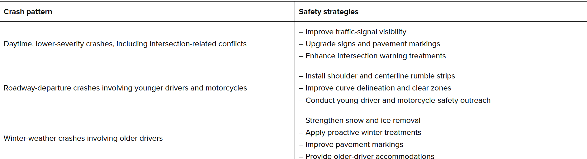
CLASS 1 · AI FOR GOOD Combination OF AI TOOLS BRING MAGIC
AI FOR GOOD
TARGET
· IUT DHAKA
13
Notes:
60–65. Introduce the fictional dataset and the status rule before anyone calculates anything. Do not reveal the calculated answers at this stage — that comes at minute 110–120. Ask learners to identify which rows are eligible toward the target and what information is still missing (e.g. whether pending orders have expected completion dates, whether cancellations have known reasons). This sets up the later independent-checking exercise.

Slide 20
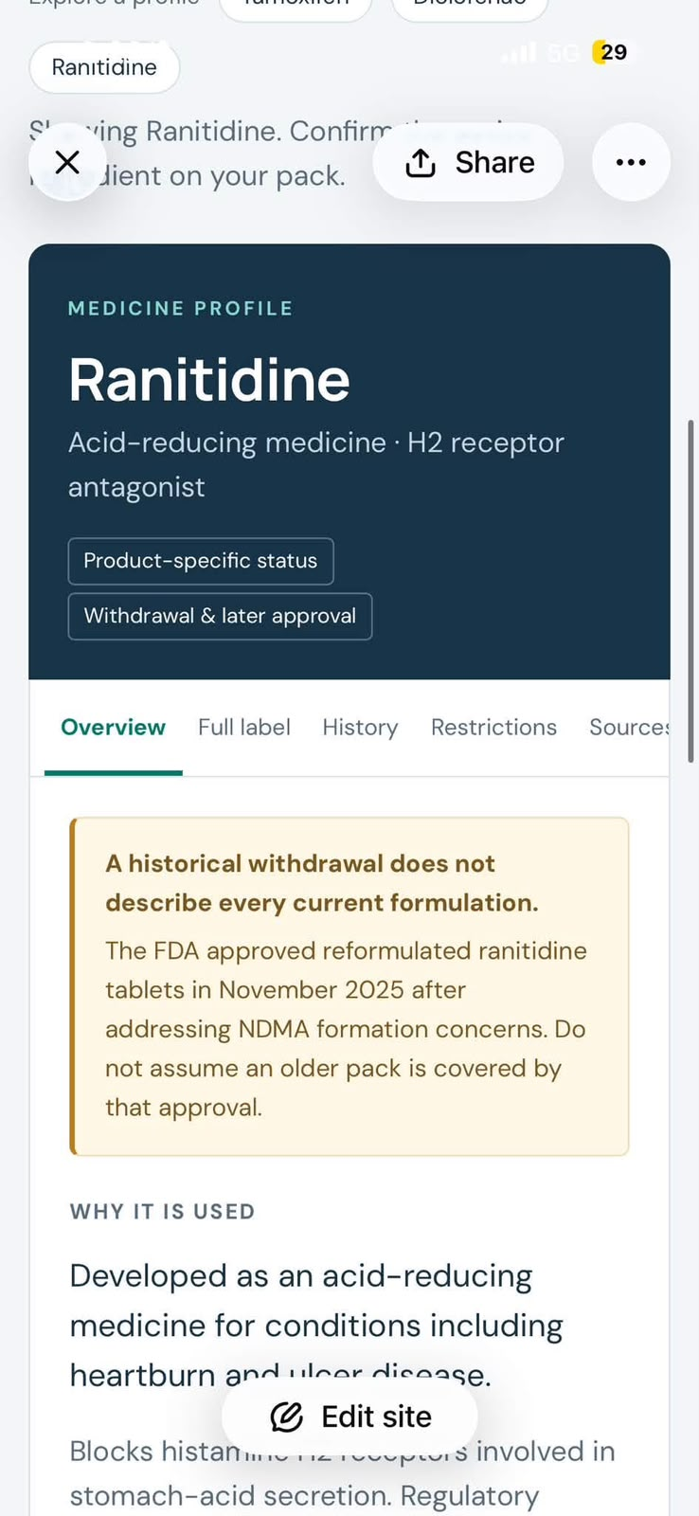
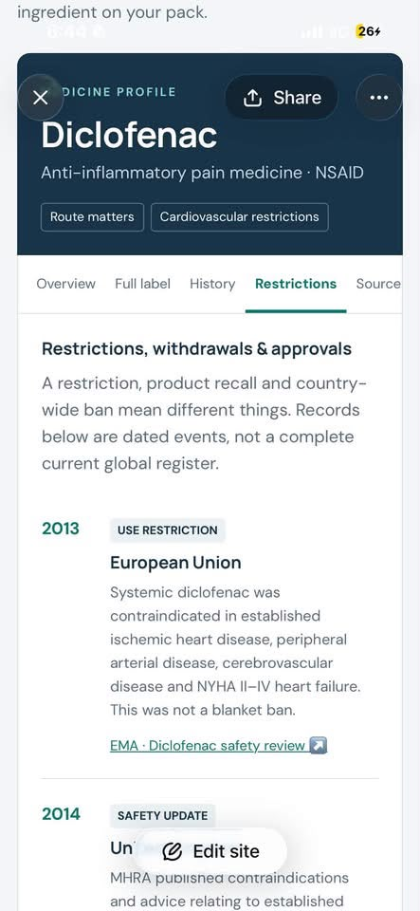
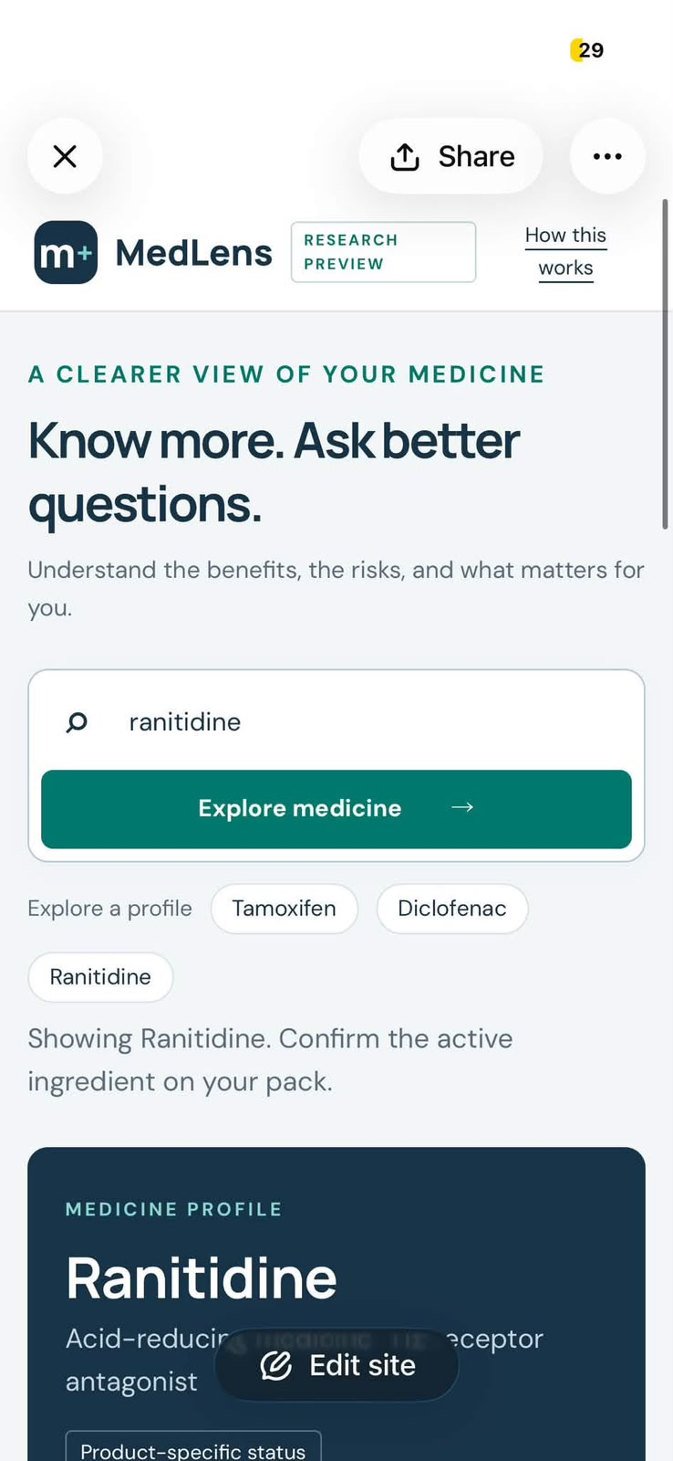
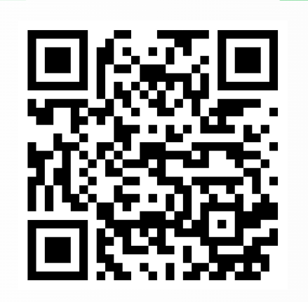
CLASS 1 · AI FOR GOOD Combination OF AI TOOLS BRING MAGIC
AI FOR GOOD
TARGET
· IUT DHAKA
13
Notes:
60–65. Introduce the fictional dataset and the status rule before anyone calculates anything. Do not reveal the calculated answers at this stage — that comes at minute 110–120. Ask learners to identify which rows are eligible toward the target and what information is still missing (e.g. whether pending orders have expected completion dates, whether cancellations have known reasons). This sets up the later independent-checking exercise.

Slide 21
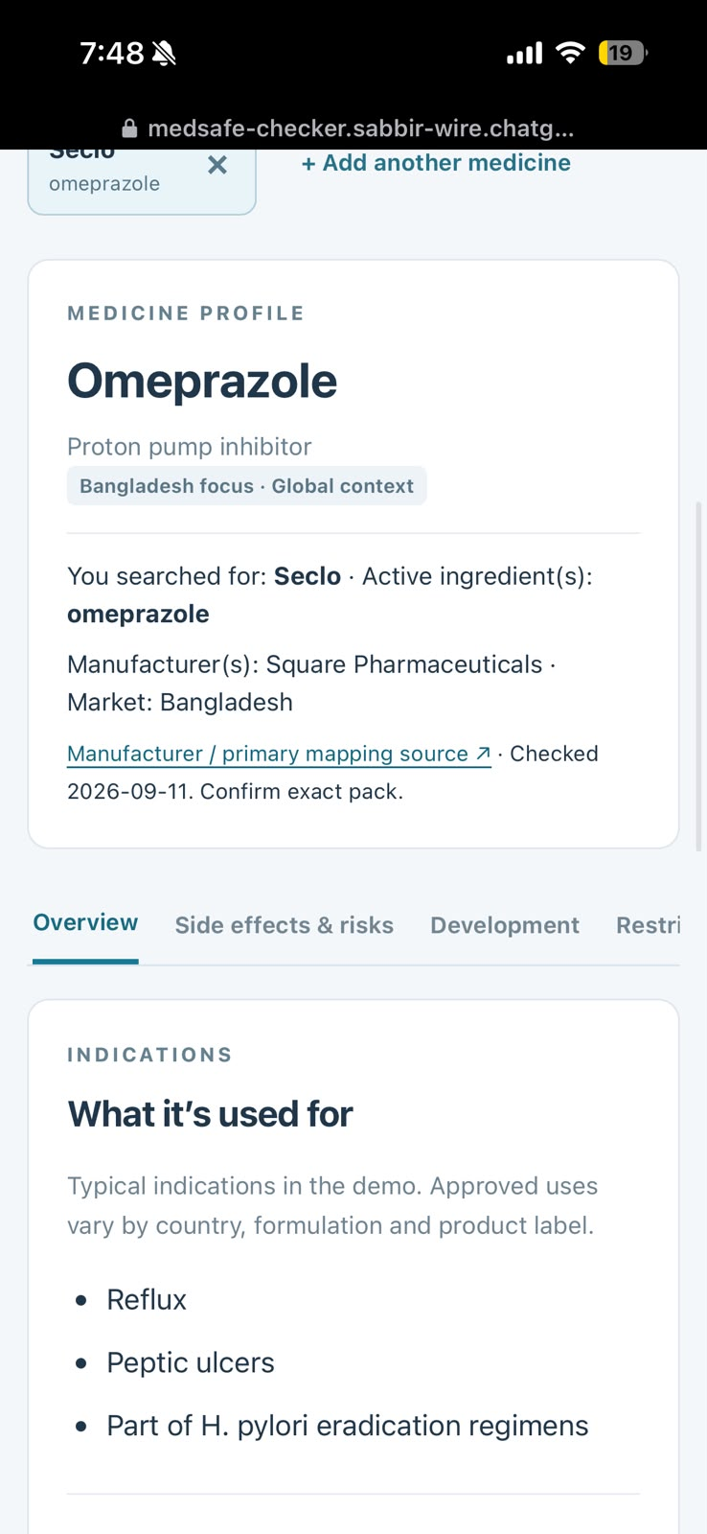
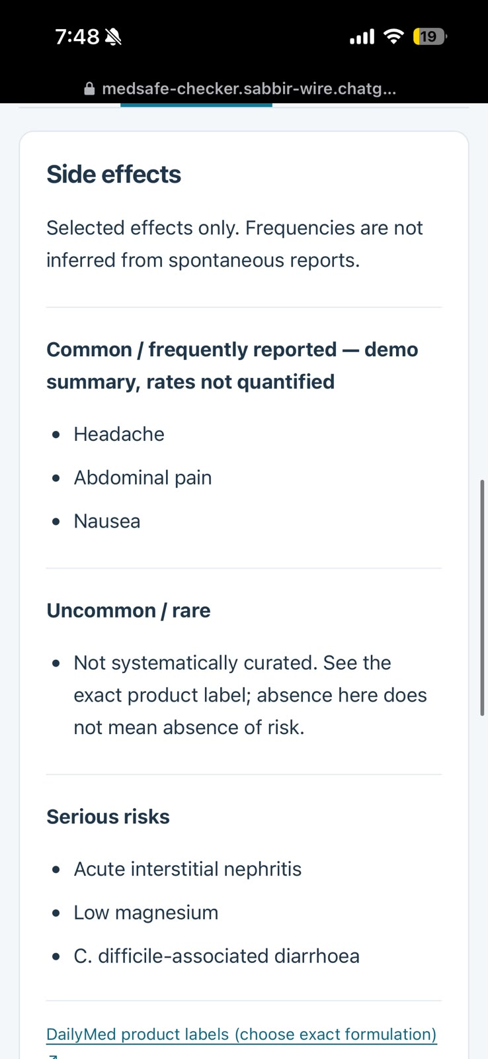
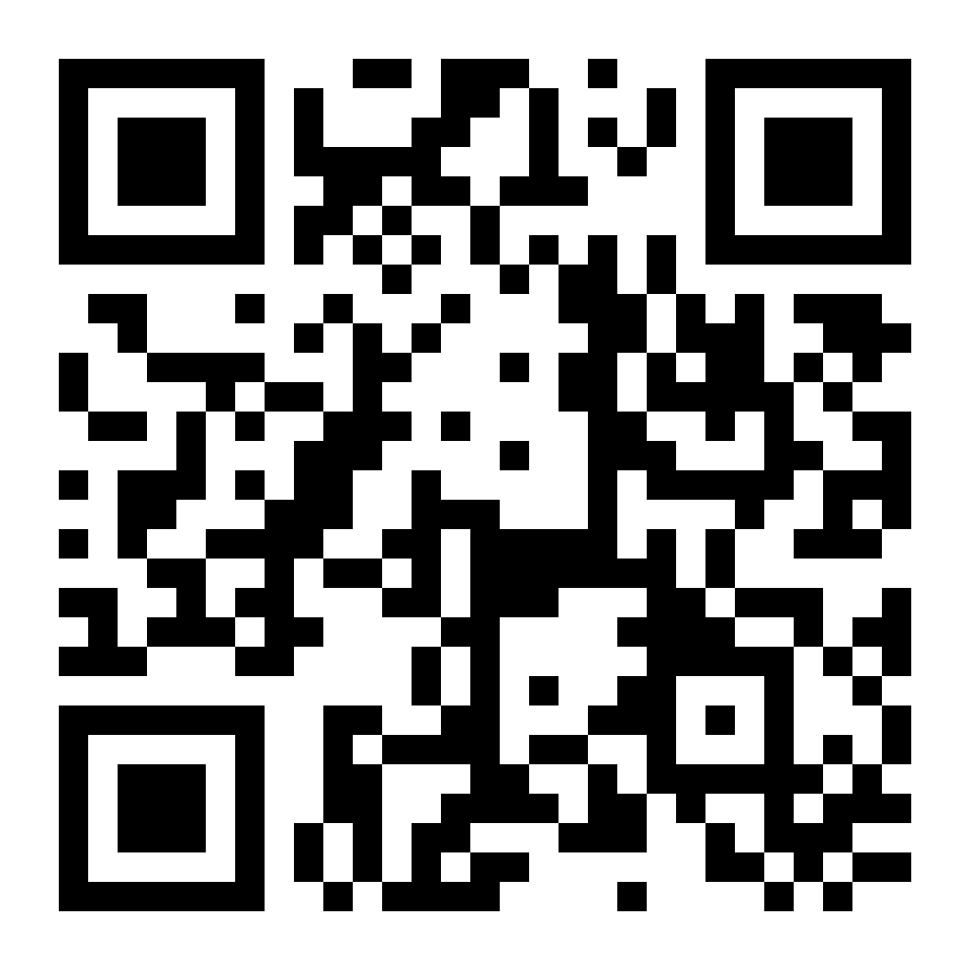
CLASS 1 · AI FOR GOOD Combination OF AI TOOLS BRING MAGIC
AI FOR GOOD
TARGET
· IUT DHAKA
13
Notes:
60–65. Introduce the fictional dataset and the status rule before anyone calculates anything. Do not reveal the calculated answers at this stage — that comes at minute 110–120. Ask learners to identify which rows are eligible toward the target and what information is still missing (e.g. whether pending orders have expected completion dates, whether cancellations have known reasons). This sets up the later independent-checking exercise.

Slide 22
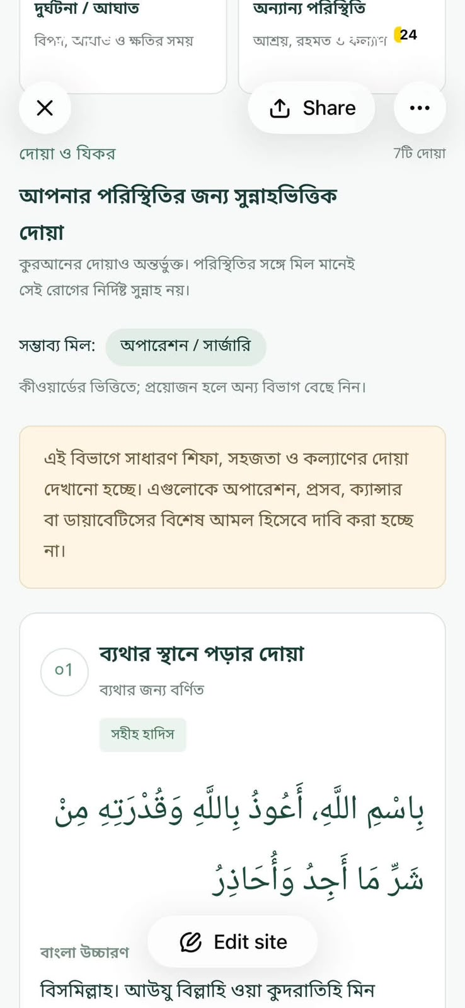
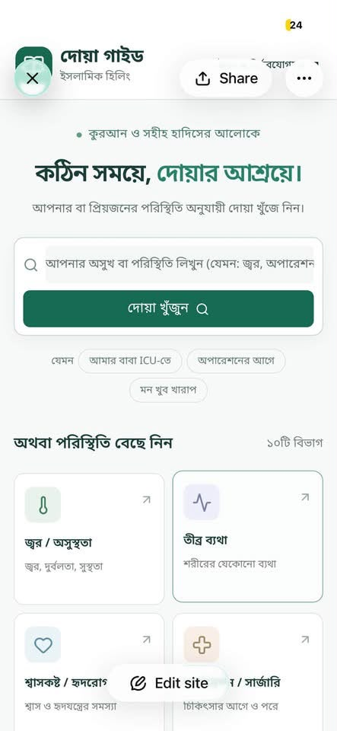
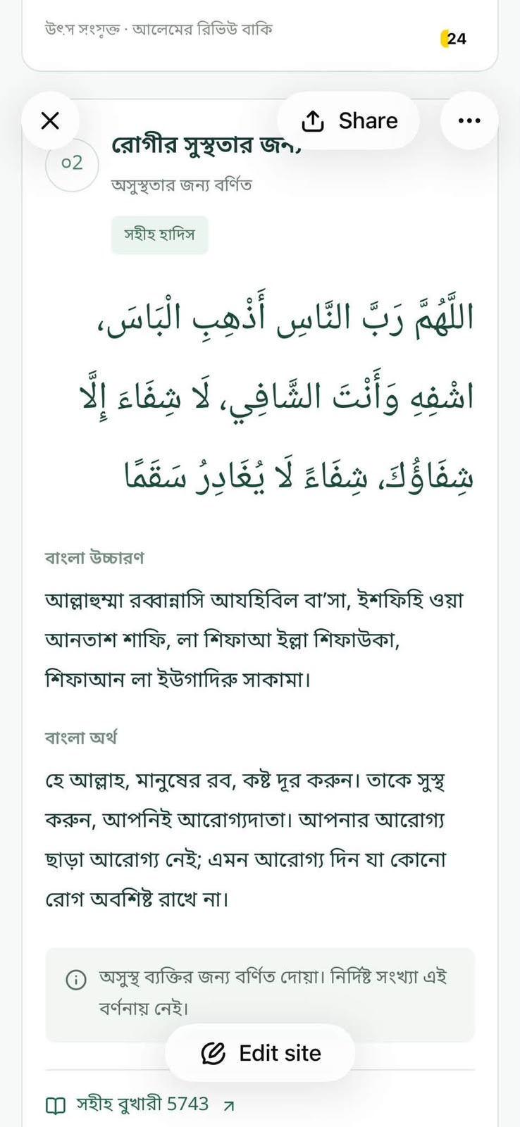
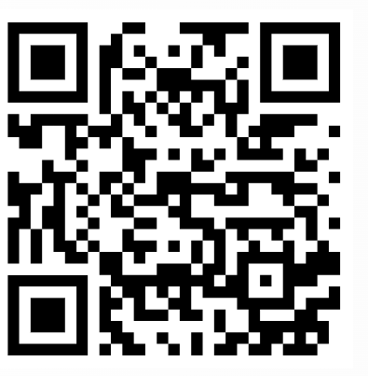
CLASS 1 · AI FOR GOOD Combination OF AI TOOLS BRING MAGIC
AI FOR ANYTHING
TARGET
· IUT DHAKA
13
Notes:
60–65. Introduce the fictional dataset and the status rule before anyone calculates anything. Do not reveal the calculated answers at this stage — that comes at minute 110–120. Ask learners to identify which rows are eligible toward the target and what information is still missing (e.g. whether pending orders have expected completion dates, whether cancellations have known reasons). This sets up the later independent-checking exercise.

Slide 23
CLASS 1 · AI AS A BUSINESS TOOL
20–30
Which Tool Do You Want to Make?
ACTIVITY · PAIRS
Choose it. Explain it. Check it. Own the decision.
Each Pair Gives Idea for their Own Product
1
2
3
4
5
6
7
8
For every product, rate:
0–1
I don’t Like it/ I don’t think it can help me/ I wont use it at all/ I hate ___
How Innovative do you think the idea is?
Who Can It Help?
Would you Use it Everyday?
What do you not like about it?
2
Slightly innovative/May Help me but not often/ I would use it once a month/ I don’t like the interface/design/etc.
3-4
I think its pretty innovative/ It will help me or someone I know on a regular basis/ I would use it at least twice a week/ I am not comfortable with _
5
Love everything about it, will use it at least 5x a week, it will help me anda lot of people I know, theres not much about it not to like.
Best Product will be Made · IUT DHAKA
08
Notes:
20–30. Full ten-minute game, four rounds as shown. Distribute two cards per pair from the eight-card set (warranty terms / supplier comparison / customer email / recent statistics / five-slide pitch / spreadsheet analysis / landing-page prototype / form-triggered notification). Give one point for each well-explained element — not for naming a favorite platform. Multiple answers can be reasonable; the goal is the reasoning, the verification method, and the identified human decision, not a single correct tool.

Slide 24
CLASS 1 · AI AS A BUSINESS TOOL
40–50
Prompt Relay
ACTIVITY · SOLO+PAIR
Make your own Business
Improve the brief. Pass the context. Check what changed.
Choose your Business Idea with your partner and generate a deep research prompt
Use GPT sol and its basic deep research prompt to train the thread.
Transfer improved prompt + context to a second tool and create the presentation.
Polish and improve output with your partner and check each other’s output.
Record one improvement, one problem, one verification step and launch.
Minimum success: one useful prompt improvement and one checked output.
10
Notes:
40–50. Improvement instruction to give learners verbatim: 'Improve this prompt so it specifies the customer, problem, fictional constraints, required output, assumptions, and a low-cost test. Do not invent missing context. Ask for it or use clearly labeled placeholders.' If only one tool is accessible to a pair, use two separate conversations instead and discuss the substitution openly — do not describe that as a tested cross-platform comparison.

Slide 25
CLASS 1 · AI AS A BUSINESS TOOL
50–55
One Workspace, One Purpose
“Think of an AI workspace as a temporary working partner for one objective: a clear role, relevant context, a defined output, and follow-up instructions.”
1
2
3
One workspace, one purpose
Clear role
Stable background context
4
5
6
Reusable instructions
Repeated output format
Human approval point
A Project, thread, workspace, or document can help — but AI can still misunderstand, lose context, invent information, or overgeneralize. It does not become your brain. A person still checks important facts and decisions.
Start a new workspace when:
different project, client, audience, or data sensitivity · different objective or conflicting instructions · different writing style or output format
MEGHNA OFFICE SUPPLIES WORKSHOP · IUT DHAKA
11
Notes:
50–55. Elements to teach, in order: one workspace / one purpose; clear role; stable background context; reusable instructions; a repeated output format; a verification checklist; a human approval point. Note that a Project, thread, workspace, or document can organize context but these are not identical features across platforms — ChatGPT's documentation describes organizing work through projects and chats as one example. Key caution to say aloud: restate important instructions periodically; a long conversation is not automatically better; never add sensitive information simply to preserve context. AI context and memory are not perfect — important instructions may need repeating, and important outputs must still be checked regardless of how long or well-organized the workspace is. Point learners to the 'start a new workspace when' list now visible on-slide, and connect it forward to the next slide's example.

Slide 26
CLASS 1 · AI AS A BUSINESS TOOL
55–60
Your Weekly Sales Analyst
A worked example of one workspace, one purpose.
Purpose
Produce a checked weekly sales update
Background
Fictional office-supplies business; currency BDT; completed orders count toward target
Required output
Five metrics, a 100-word update, missing information, proposed next steps
Rules
Use supplied data only. Exclude pending & cancelled orders. Never invent causes, profit, or forecasts
Checking method
Recalculate totals and percentages; inspect row inclusion and reporting period
Human approval
Manager approves the update — and any action — before it circulates
MEGHNA OFFICE SUPPLIES WORKSHOP · IUT DHAKA
12
Notes:
55–60. Model this workspace live, or walk through it as a slide. Learners write their own short version: purpose, two rules, a checking method, and an approval point. A single named conversation is an acceptable fallback if a full 'project' feature isn't available on their account. Start a new workspace whenever the objective, audience, sensitivity, writing style, client, or instructions change significantly — this becomes the closing rule for this whole segment.

Slide 27
CLASS 1 · AI AS A BUSINESS TOOL
70–80
Would Anyone Want This?
We're developing a hypothesis, not proving a business will succeed.
IDEA 1
IDEA 2
IDEA 3
Campus lunch preorder
Stationery replenishment
Tutoring coordination
A scheduled collection point for a limited menu
A simple restock service for office supplies
Matching students who need help with those who can give it
AI generates hypotheses, not demand evidence. “Interesting” is not the same as “validated.”
· IUT DHAKA
15
Notes:
70–80. At 70–75: ask AI for three short options (one or two sentences each) using the campus lunch example or another low-risk idea such as office stationery replenishment, tutoring coordination, or study-material organization. At 75–80: guide selection with pair feedback — choose one problem, one customer, one possible solution. Keep reminding learners that 'interesting' is not the same as 'validated.'

Slide 28
AI CONCEPTS · TOOLS · CASE STUDIES
FREE TOOLS
Free Tools, Real Differences
Five everyday AI platforms — what their free plan actually gives you.
Badges show initials in a brand-adjacent color, not the companies' official logos.
GPT
ChatGPT
C
Claude
P
Perplexity
OPENAI
ANTHROPIC
PERPLEXITY AI
• Unlimited chat on GPT-5.6 Luna
• Web search & image generation
• Limited Deep Research, Codex
• Current Sonnet model + faster Haiku
• Web search, file creation, Projects
• Memory, connectors & skills
• AI search with cited sources
• Comet browser, free on all platforms
• Limited Deep Research access
Best for: everyday Q&A, quick drafts, broad general use
Best for: longer documents, careful writing, coding help
Best for: research with sources you can verify
M
Manus
Cv
Canva
MONICA
CANVA
• Small daily credit allowance
• Agent Mode: browsing, files, data
• One task at a time on free tier
• ~50 AI credits/month (Magic Studio)
• 250,000+ free templates, 5GB storage
• Basic background remover & editing
Best for: trying autonomous tasks in small doses
Best for: quick social posts, decks, simple video
MEGHNA OFFICE SUPPLIES WORKSHOP · IUT DHAKA
08 / 08
Notes:
Sources (verify before class — free-tier terms change often): ChatGPT free tier (techrepublic.com, engadget.com, gradually.ai, Aug 2026); Claude free tier (fast.io 'Is Claude AI Free?', Anthropic's own Feb 2026 free-plan-expansion announcement on X covering file creation/connectors/skills — cross-check against claude.ai/pricing for the exact current model); Perplexity free tier (secondtalent.com 'Perplexity AI Features 2026'); Manus free tier (ssojet.com, nocode.mba — credit numbers conflict across sources, treat as directional); Canva free tier (fast.io Canva AI review, eesel.ai Canva AI pricing, 2026). 'Manus' is assumed here — if the intended tool was something else, swap the card.

Slide 29
CLASS 1 · AI AS A BUSINESS TOOL
30–40
One Idea Visits Four Tools
Fictional case: a campus lunch preorder concept — a hypothesis, not a proven demand.
1
2
3
4
5
6
Research
Brief
Draft
Critique
Slides
Check
Find an official source; note claim & gaps
Separate facts, verified info, assumptions
Concise concept, under 180 words
Check against brief; no new facts added
5-slide outline; assumptions preserved
Label what's evidence, what's hypothesis
09
Notes:
30–40. Live demonstration, not a full wait-for-results run — use prepared saved outputs as backup if any platform stalls; say 'this is a prepared example of the next stage' and move on. Stage detail: (1) Research — ask a source-oriented question about the actual capability of a tool like Google Forms for interest surveys, get a URL, a supported claim, and three business questions the source cannot answer. (2) Brief — turn findings into a reusable brief separating supplied facts, verified tool info, and assumptions; preserve the source URL. (3) Draft — paste the brief into a second tool for a concise draft, two assumptions, one low-cost demand test, no invented statistics. (4) Critique — a third tool reviews the draft against the brief for unsupported claims and missing constraints, improving structure without adding new facts. (5) Slides — paste the approved structure into a presentation tool for exactly five slides, preserving assumptions and links. (6) Check — ask learners which statement needs evidence and which remains a hypothesis. Final five-slide structure: customer problem (hypothesis) / proposed service & customer / revenue model & resources / assumptions & unanswered questions / low-cost test & human decision.

Slide 30
80–90
Human Recharge
10-MINUTE BREAK
RETURN AT
____:____
Notes:
80–90. Display the exact return time on screen before stepping away and do not resume teaching content during the break. Return promptly at minute 90 to introduce the business-concept prompt.

Slide 31
CLASS 1 · AI AS A BUSINESS TOOL
90–105
Your First Business Concept
FACT from your own input
ASSUMPTION unverified, could be wrong
ESTIMATE illustrative, not measured
RECOMMENDATION a suggestion, not proof
Concept
Target customer
Problem & proposed solution
Value proposition
Revenue model
Costs / resources
Marketing channel
2 assumptions or risks
1 low-cost test
3 questions only you can answer
Tag every claim with one of the four labels above. Never present an assumption as a fact. No invented statistics, prices, or profits — illustrative numbers are labeled as estimates.
Peer review: your partner asks
Which claim sounds factual but lacks evidence?
Is the test cheaper and safer than launching?
~350 words · keep your own revised version after peer review
MEGHNA OFFICE SUPPLIES WORKSHOP · IUT DHAKA
17
Notes:
90–105. 90–95: introduce the business-concept prompt (full text on the handout); learners enter their fictional context and answer up to three clarifying questions the assistant asks. Point out the four labels at the top — Fact / Assumption / Estimate / Recommendation — and ask learners to tag each line of their concept with one as they write, not after. 95–100: coach refinement toward a concise concept with clear assumptions and a test, capped at roughly 350 words. 100–105: peer review — the partner identifies one unsupported claim, and the learner revises. Each learner keeps their own version after revising. No single correct business idea exists here — look for coherence and honest uncertainty, not confident projections.

Slide 32
CLASS 1 · AI AS A BUSINESS TOOL
105–120
The THREADS Have a Job
CEO
CBO
CFO
Remaining Organization
Remaining Organization
?
?
?
?
?
Make your Agents. Put your Idea into reality.
· IUT DHAKA
18
Notes:
105–120. 105–110: give the management-update task — generate five metrics and a management update from the Meghna data using the copy-ready prompt from the handout. 110–115: require independent checking — calculate manually or with a spreadsheet/calculator; do not use another AI as the only checker. 115–120: coach a follow-up prompt to correct or refine the update, and have learners record what changed. Keep the answer key hidden until this point. Correct answers: Completed sales BDT 57,000; Pending BDT 39,000; Cancelled BDT 12,000; Target achieved 47.5%; Remaining gap BDT 63,000. If all pending later completed: BDT 96,000 completed, 80% achieved, BDT 24,000 gap remaining — a conditional calculation, not a prediction.

Slide 33
CLASS 1 · AI AS A BUSINESS TOOL
120–125
Confidently Wrong
“Making the CEO do the CFO’s job and making the CFO do the designers job doesn’t make sense. Treat it like a real world program.”
School
Business
Social Good
NGO
Government
For each claim: classify it, explain the evidence (or its absence), then correct it. Feel free to change the roles according to your wish but ask the instructor first.
“Fluent language can combine a correct fact, a wrong calculation, an invented explanation, and an unsupported recommendation in one convincing paragraph.”
· IUT DHAKA
19
Notes:
120–125. Reveal the full flawed statement in short chunks, then the answer key. Statement: 'There is one cancelled order. Meghna has achieved BDT 108,000 in completed sales, reaching 90% of its target. Sales are growing strongly because customers prefer its lower prices. All pending orders will complete tomorrow, so the company will exceed its target this month. Management should increase inventory by 30%.' Key: cancelled-order count — Supported. BDT 108,000 / 90% — Incorrect (adds all statuses; correct figures are BDT 57,000 and 47.5%). Growth claim, price-preference claim, completion-tomorrow claim, exceed-target claim — all Not established (no supporting data). Inventory increase — Recommendation lacking demand, stock, cost, and capacity evidence. Split compound claims before classifying. The fifth label, Requires verification, doesn't appear in this particular statement but is worth naming explicitly: it's for a claim that might be true but can't be judged from the data in front of you — the fix is checking an outside source, not recalculating (contrast with Not established, which means the supplied data plainly doesn't support the claim either way). Corrected version (read aloud): 'Meghna has BDT 57,000 in completed sales, achieving 47.5% of its BDT 120,000 target. Pending orders total BDT 39,000, and one cancelled order totals BDT 12,000. The current gap is BDT 63,000. Even if all pending orders complete, a BDT 24,000 gap remains. Growth, customer preferences, completion timing, and inventory requirements cannot be established from this table.'

Slide 34
CLASS 1 · AI AS A BUSINESS TOOL
120–125
Everything is about Algorithm
“Combine all the Human Parts.”
Know what you Want
Think about what you need to train on and Generate the Prompt
Choose the Right Platform to Place it
Train and Retrain your Model based on your Requirement
Prompt and Execute
“Fluent language can combine a correct fact, a wrong calculation, an invented explanation, and an unsupported recommendation in one convincing paragraph.”
· IUT DHAKA
19
Notes:
120–125. Reveal the full flawed statement in short chunks, then the answer key. Statement: 'There is one cancelled order. Meghna has achieved BDT 108,000 in completed sales, reaching 90% of its target. Sales are growing strongly because customers prefer its lower prices. All pending orders will complete tomorrow, so the company will exceed its target this month. Management should increase inventory by 30%.' Key: cancelled-order count — Supported. BDT 108,000 / 90% — Incorrect (adds all statuses; correct figures are BDT 57,000 and 47.5%). Growth claim, price-preference claim, completion-tomorrow claim, exceed-target claim — all Not established (no supporting data). Inventory increase — Recommendation lacking demand, stock, cost, and capacity evidence. Split compound claims before classifying. The fifth label, Requires verification, doesn't appear in this particular statement but is worth naming explicitly: it's for a claim that might be true but can't be judged from the data in front of you — the fix is checking an outside source, not recalculating (contrast with Not established, which means the supplied data plainly doesn't support the claim either way). Corrected version (read aloud): 'Meghna has BDT 57,000 in completed sales, achieving 47.5% of its BDT 120,000 target. Pending orders total BDT 39,000, and one cancelled order totals BDT 12,000. The current gap is BDT 63,000. Even if all pending orders complete, a BDT 24,000 gap remains. Growth, customer preferences, completion timing, and inventory requirements cannot be established from this table.'

Slide 35
CLASS 1 · AI AS A BUSINESS TOOL
125–130
Your Idea Gets a Reality Check
Apply the same audit habit to your own business concept.
What do we know?
What are we assuming?
Which claims came from my own input?
Which claims did AI introduce?
Which numbers are estimates, not facts?
Which claims need external research?
Which assumptions could invalidate the idea?
What should I test before spending money?
Required: 2 labeled assumptions · 1 claim removed or qualified · 1 low-cost test
MEGHNA OFFICE SUPPLIES WORKSHOP · IUT DHAKA
20
Notes:
125–130. Focus on the two most important uncertainties rather than trying to audit everything. Remind learners that a claim they themselves supplied is not automatically true either — the audit habit applies to their own input, not just AI output.

Slide 36
CLASS 1 · AI AS A BUSINESS TOOL
130–140
Your Personal AI Work Stack
Three repeatable tasks. Clear inputs and outputs. A human approval point.
SAMPLE ROW
Task
Capability
Output
Approval
Any Businesss Task
Analysis/ Research/ Draft/ Prepare/ GTM/ Launch
5 metrics + 100-word update
Pair
Now build three of your own:
1
Task → Input → Tool → Required output → How I'll check → Approval
2
Task → Input → Tool → Required output → How I'll check → Approval
3
Task → Input → Tool → Required output → How I'll check → Approval
Peer-review test: can someone else tell exactly what goes in, what comes out, and who checks it?
MEGHNA OFFICE SUPPLIES WORKSHOP · IUT DHAKA
21
Notes:
130–140. 130–135: learners select three tasks from their earlier 10-task inventory and fill three rows using the full template (task / input / primary capability / tool or category / required output / how I'll check / human approval point). Reject vague tasks — 'do marketing' becomes 'find three official sources about this product category and summarize evidence and gaps'; 'manage my business' becomes 'turn this week's sales table into five verified metrics and a 100-word update'; 'make a presentation' becomes 'turn this approved concept into five slides while preserving assumptions and source links'; 'handle meetings' becomes 'turn anonymized notes into decisions, owners, deadlines, and unresolved items.' 135–140: peer review — a partner checks tool fit, verification method, and approval point, and the learner revises anything vague.

Slide 37
CLASS 1 · AI AS A BUSINESS TOOL
140–145
Homework: One Real Win
Do it. Check it. Show what changed.
10-POINT RUBRIC
Choose a real task — public, fictional, or safely anonymized input only
Turn public study material into a checked summary
Compare official product specifications
* Create a Routine Automated System.
Refine a business idea and flag what needs testing
Make the Business
/2
Useful input, clear output
/2
Meaningful verification
/2
Follow-up & refinement
/2
Reflection & approval point
/2
~45–60 minutes, including verification · confirm the actual deadline in class
Submit: task & outcome · tool & why · prompts & outputs · verification & corrections · time spent · human approval point.
Do not claim time savings unless you have a reasonable comparison — actual elapsed time is enough.
MEGHNA OFFICE SUPPLIES WORKSHOP · IUT DHAKA
22
Notes:
140–145. Explain the homework mission and rubric; confirm the actual deadline and submission channel before class ends. Full submission list (13 items) is in the handout: task and desired outcome, tool(s) used and why, input used, first prompt and response, at least one follow-up prompt, final output, verification steps, corrections made (or what was checked if none needed), actual time spent including verification, what AI helped with, what still required human work, human approval point, and whether they'd use the same tool again and why.

Slide 38
CLASS 1 · AI AS A BUSINESS TOOL
145–149
Your Next Move
Individual exit ticket — five short answers.
TASK
TOOL
What specific task will you try next?
Which tool or category, and why?
CHECK
HUMAN DECISION
What will you check before using the output?
Which decision stays yours?
Confidence now, 1–5:
1
2
3
4
5
MEGHNA OFFICE SUPPLIES WORKSHOP · IUT DHAKA
23
Notes:
145–149. Collect individual responses, not pair or group answers — this is evidence of individual learning. Six prompts in the full handout version: task, tool/category and why, what to check, which decision stays theirs, what's still unclear, and confidence now on a 1–5 scale (compare against their opening confidence from slide 2).

Slide 39
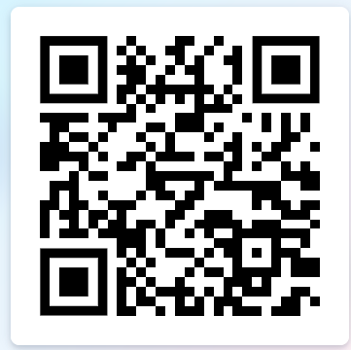
149–150
Choose well.
Check carefully.
Keep the decision human.
State one next action before you leave.
S
R
G
A
Au
Notes:
149–150. Close exactly at minute 150. Final line to say aloud: 'Choose well. Check carefully. Keep the decision human.' Connect tool choice explicitly to responsibility — the tool changes what's easy to produce; it does not change who is accountable for the result.

